Slide 1
Presentation on The Dicing in The Mahabharata by Vyasa
Ujjwal Biswas
Assistant Professor
Department of English
Semester – II
Session-2021-22
Khatra Adibasi Mahavidyalaya

Slide 2
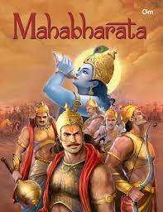
The Mahabharata
The Mahābhārata is one of the two
major Sanskrit epics of ancient
India in Hinduism, the other is
the Rāmāyaṇa. It also
contains devotional and philosophical
issues, such as a discussion of the four
"goals of life" or puruṣārtha.
The Mahābhārata is the longest
epic poem. Its longest version
consists of over 100,000 śloka or over
200,000 individual verse lines (each
shloka is a couplet), and long prose
passages

Slide 3
Important Characters
Yudhisthira : He is the eldest of the Pandava brothers. Yudhisthira is their leader as both king and commander in battle.
Arjuna: One of the Pandavas brothers. He is a skilled archer trained by Drona.
Bhima: The strongest of the Pandavas.
Duryodhana: The leader of his brothers. Duryodhana is portrayed as living in blatant infringement of dharma.
Draupadi: The wife of the five Pandava brothers.
Dhritarashtra: He is the blind king of Hastinapur . He believes his blindness is a curse upon him.
Karna: Karna is biologically the oldest of the Pandava brothers, but was raised by adoptive parents.
Krsna: The god who assists the Pandavas throughout the story.
The cunning Sakuni: an infamous dice player.

Slide 4
Aristotelian Epic Poem
Aristotle in his Poetics discusses the features of an epic:
1. It is a narrative poem written in heroic hexa-metre.
2. Its length is considerable.
3. It has four constituent parts namely plot , character, thought, & diction.
4. Epic encompasses the life of an entire period and deals with an action that determines the fortunes or destiny of a nation.
5. The marvellous has a function in epic.

Slide 5
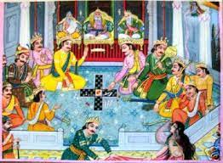
Central Issues
Allegorical story of Spirituality and Materialism
Deceiving aspect of Illusion
Jealousy
Retribution
Trickery
Dharma
Women Objectification

Slide 6
Thank You

